Slide 1
KBQS – Capstone project Risk Management in maintenance aviation
Naila Mendes
Professional Certificate in ML & AI - March 2022
UC Berkeley – Berkeley Haas

Slide 2
Summary
Introduction
EDA
KBQS Application
Application
Results & Discussion
Conclusion

Slide 3
Introduction
Risk Management
“Risk management is a control function focused on maintaining a particular hazardous, productive process within the boundaries of safe operation and that a system approach based on control theoretic concepts should be applied to describe the overall system functions” (Rasmussen 1997)
ICAO – Safety Management System: Safety Risk Management
Death rate 1:9.87 billion passengers (IATA, 2018 & ICAO, 2019)

Slide 4
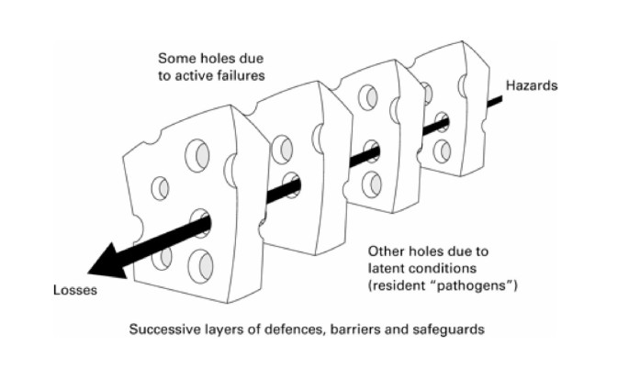
Introduction – RM Current Methods
Reactive methods
Investigate incidents, their causes, recommend corrective action (Oster et al. 2013)
Proactive methods
Risk analysis from hazard reports, causes, corrective action
Collects and performs root cause analysis
Interactive methods
Actively provides feedback to decision making personnel is considered interactive
Predictive methods
Predict error and probability using human models (Claros et al., 2017)
Organizations need an early recognition of latent risks and offer timely and targeted countermeasures. Proactive and predictive countermeasure for eliminating threats or risks on high reliability organizations, specifically in aviation industry.

Slide 5
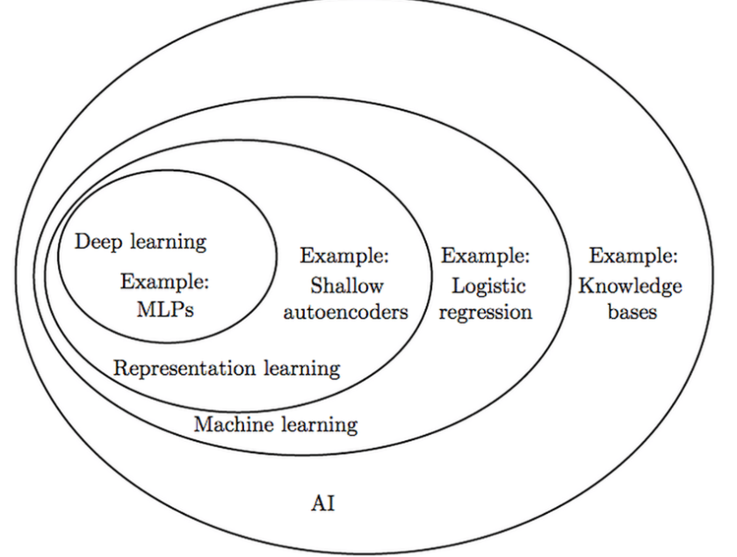
Objective
Goal
Predict the most relevant/risk factors on a maintenance service center as well as predict the overall risk using a machine learning model. Reduce the risk, increase customer satisfaction, protect the brand.
AI/ML Tools:

Slide 6
Objective – AI/ML Model
Modeling Techniques
Linear regression to determine each feature impact and Classification Models.
Expected results:
Create an accurate recommendation/classification model
Identify the feature importance based on the model and selected data

Slide 7







Maintenance Process
(f) Supporting work process
(b) Preliminary Inspection
(c) In process Inspection
(d) Final Inspection
(e) Closure
(a) Scheduling & Planning
Initial general visual inspection
Work order review
Additional Requirements Review
Remove/ Disassembly
Clean
Inspect
Repair
Install/ assemble
Test/ Checks
Verify all discrepancies/ tasks closed
Verify all part was reinstalled/panels closed
Final ops tests
Service all fluids/check pressure
Final general visual inspection
Final record of maintenance
Archive work order and related documents
Request for service
Schedule
Planning
Work order preparation

Slide 8
Literature review on Risk Management
Reactive methods
selection of root cause and contributing factors can be arbitrarily, that select chaining conditions subjectively and fail to consider systemic factors (Lower et al., 2018; Leveson, 2016).
focus on “seeking a singular root cause of an accident and often halting the investigation when a source of blame is identified” (Allison et al., 2017, Leveson, 2004).
makes it tempting to draw a line between the latent conditions and the outcome, leading to hindsight bias (Reason et al., 2006).
fail to consider that an event can create a condition that creates another condition (Leveson, 2016).
Proactive methods
process can be incomplete and inconsistent due to competitive organizational pressures (Lofquist, 2010)
hardly ever captures all potential undesired conditions due to system complexity (Lofquist, 2010)

Slide 9
Literature review on Risk Management
Proactive – Human Reliability Analysis
probabilistic risk assessment (PRA)
latent design errors may be ignored and not be corrected due to over confidence, historical data do not include this type of errors or unsafe management decisions, and consequently these factors create an inaccurate calculation (Leveson, 2016).
component interaction accidents are not considered, and the models usually assume only component failure accidents, ignores systemic failures(Leveson, 2016).
the uncertainty of the data and the difficulty in modeling human behavior (Aju Kumar et al, 2015).
Interactive methods
system approach
Aviation can be considered a system of systems, comprising numerous complex and independent agents across a wide network, working in collaboration
Active learning interface
Predictive methods
Predict error and probability using human models (Claros et al., 2017)
methods found were conceptual methods
AI limitations is being able to ensure that the content of the information and quality of the data provided has high quality implementing

Slide 10
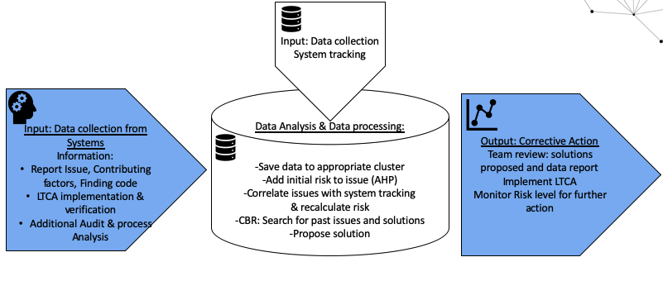
KBQS Methodology
KBQS Process
Data collection and monitoring
Data Analysis and processing
Corrective Action Implementation

Slide 11
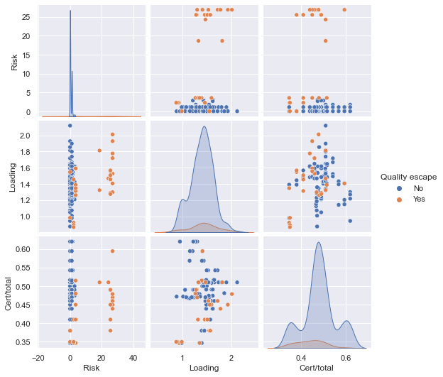
AI/ML Model – Data Understanding
Modeling Techniques that will be used are Linear regression to determine each feature impact and Classification Models.
The Expected results: Create an accurate recommendation/classification model
Identify the feature importance based on the model and selected data

Slide 12
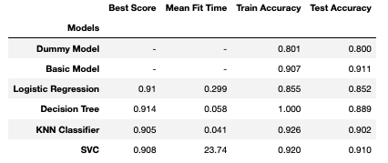
Models – Comparison & Overview

Slide 13
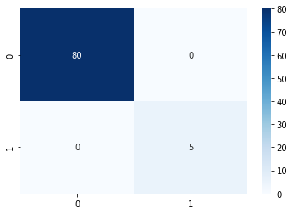
Final and improved model
KNN Classifier
KNN Classifier Best Params: {'knn__algorithm': 'auto', 'knn__n_neighbors': 10, 'knn__weights': 'uniform’}
KNN Classifier Accuracy: 0.9694871794871794KNN Classifier Mean Fit Time: 0.00401986903614468
Changed verbose to True and n_neighbors to 13
KNN Classifier Train score1: 1.0KNN Classifier Test score1: 1.0

Slide 14
Limitations and Future research
Future research
Additional data inputs from the system can be added and correlated to data that was previously corrected further adjusting risk weights and improving predictability results.
Other techniques such as Case Based Reasoning, NLP, Ensemble techniques, and Deep Learning techniques can be applied to the model.

